Slide 1

Module 5 – Advanced Analytics on Big Data
K- means Clustering

Slide 2

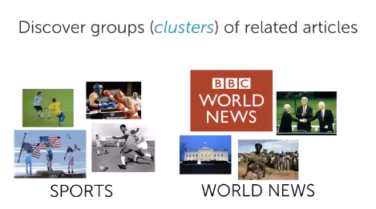
Advanced Analytics on Big Data
Goal of Clustering- Structure documents by Topic

Slide 3
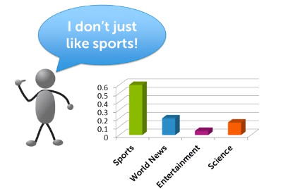
Advanced Analytics on Big Data
When Clustering is useful?

Slide 4
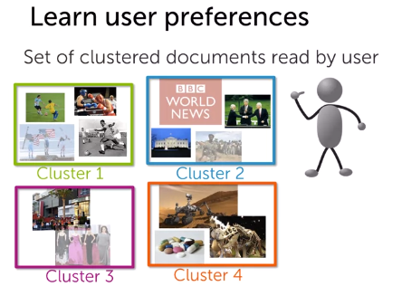
Advanced Analytics on Big Data
When Clustering is useful?

Slide 5
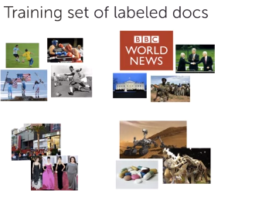
Advanced Analytics on Big Data
What if some labels are known?

Slide 6
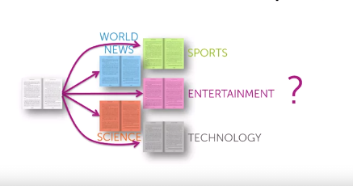
Advanced Analytics on Big Data
Multiclass Classification Problem

Slide 7

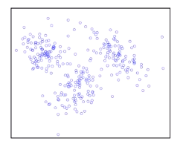
Advanced Analytics on Big Data
Clustering

Slide 8
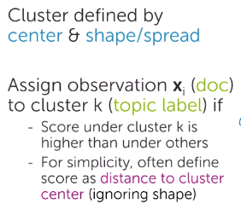
Advanced Analytics on Big Data
What defines a Cluster?

Slide 9
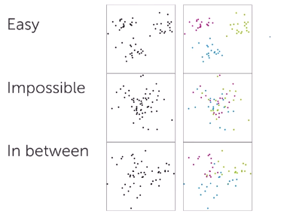
Advanced Analytics on Big Data
Given data points…..

Slide 10
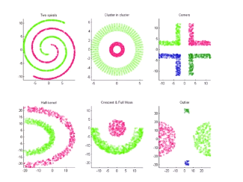
Advanced Analytics on Big Data
Challenging Cluster

Slide 11
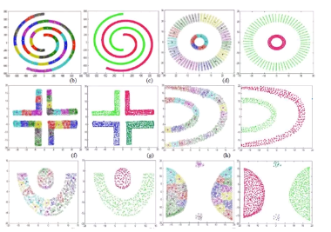
Advanced Analytics on Big Data
Challenging Cluster

Slide 12
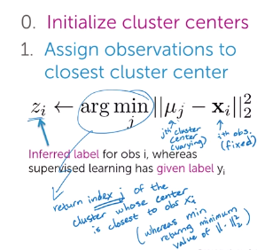
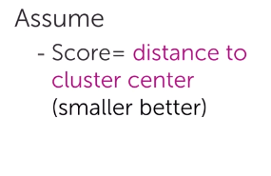
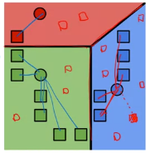
Advanced Analytics on Big Data
K-Means Clustering

Slide 13
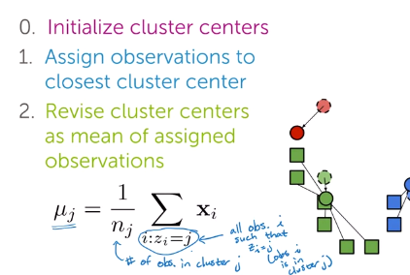
Advanced Analytics on Big Data
K-Means Clustering

Slide 14
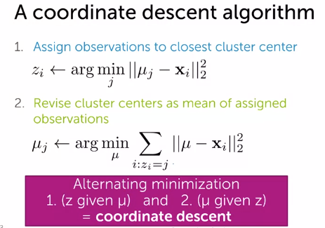
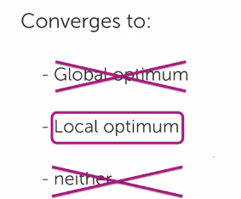
Advanced Analytics on Big Data
K-Means Clustering

Slide 15
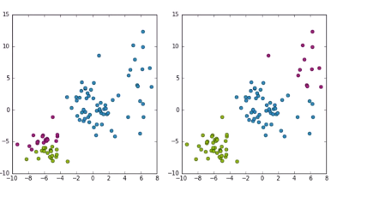
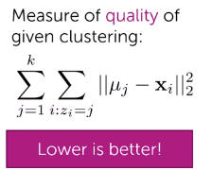
Advanced Analytics on Big Data
Which Cluster is preferred?

Slide 16
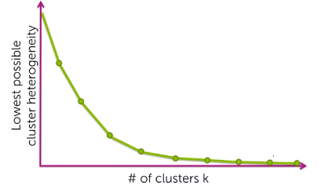
Advanced Analytics on Big Data
How to choose K?

Slide 17
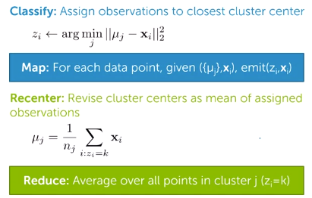
Advanced Analytics on Big Data
Map Reduce for K-means

Slide 18
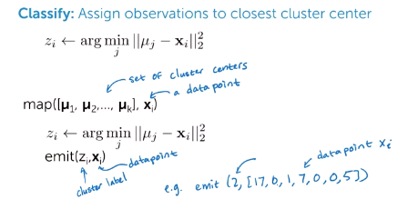
Advanced Analytics on Big Data
Map Reduce for K-means

Slide 19
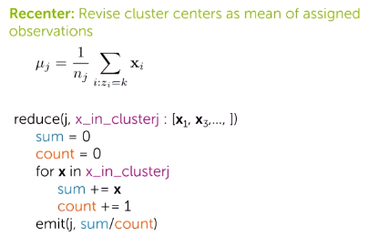
Advanced Analytics on Big Data
Map Reduce for K-means

Slide 20
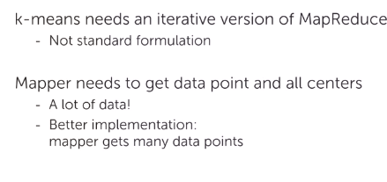
Advanced Analytics on Big Data
Practical Considerations

Slide 21
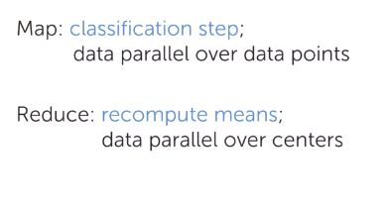
Advanced Analytics on Big Data
Summary

Slide 22
THANK YOU

